Slide 1
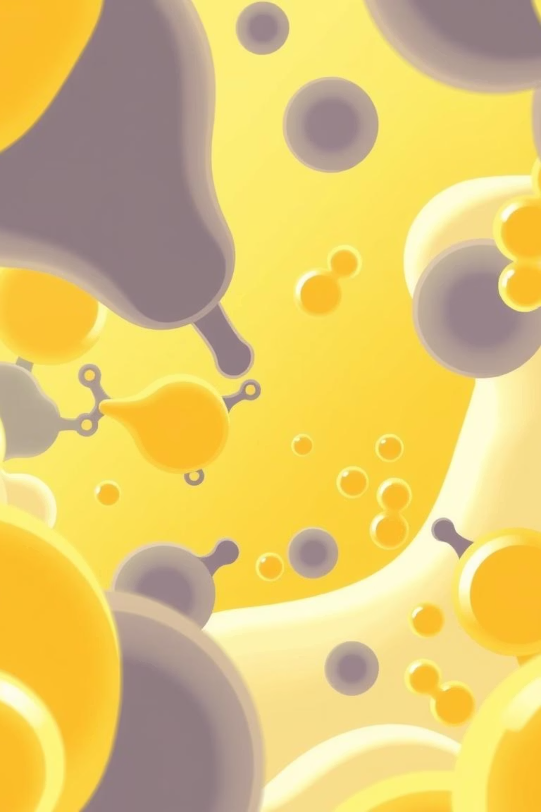
Alpha Amylase: The Foundation of Fermentation
Alpha-Amylase is a powerful enzyme critical in the brewing and distilling industries. It acts as a biochemical catalyst, specifically used for breaking down complex starch molecules into smaller, fermentable sugar chains known as Dextrin.
This enzymatic action is most effective at elevated temperatures, typically around 65-80°C, during the liquefaction phase of starch conversion. Its role is pivotal in transforming starch-rich raw materials, such as grains or potatoes, into the necessary simple sugars that yeast can then convert into alcohol. Without alpha amylase, the efficient fermentation required for high-quality spirits would not be possible, making it an indispensable component in this distilling industry.

Slide 2
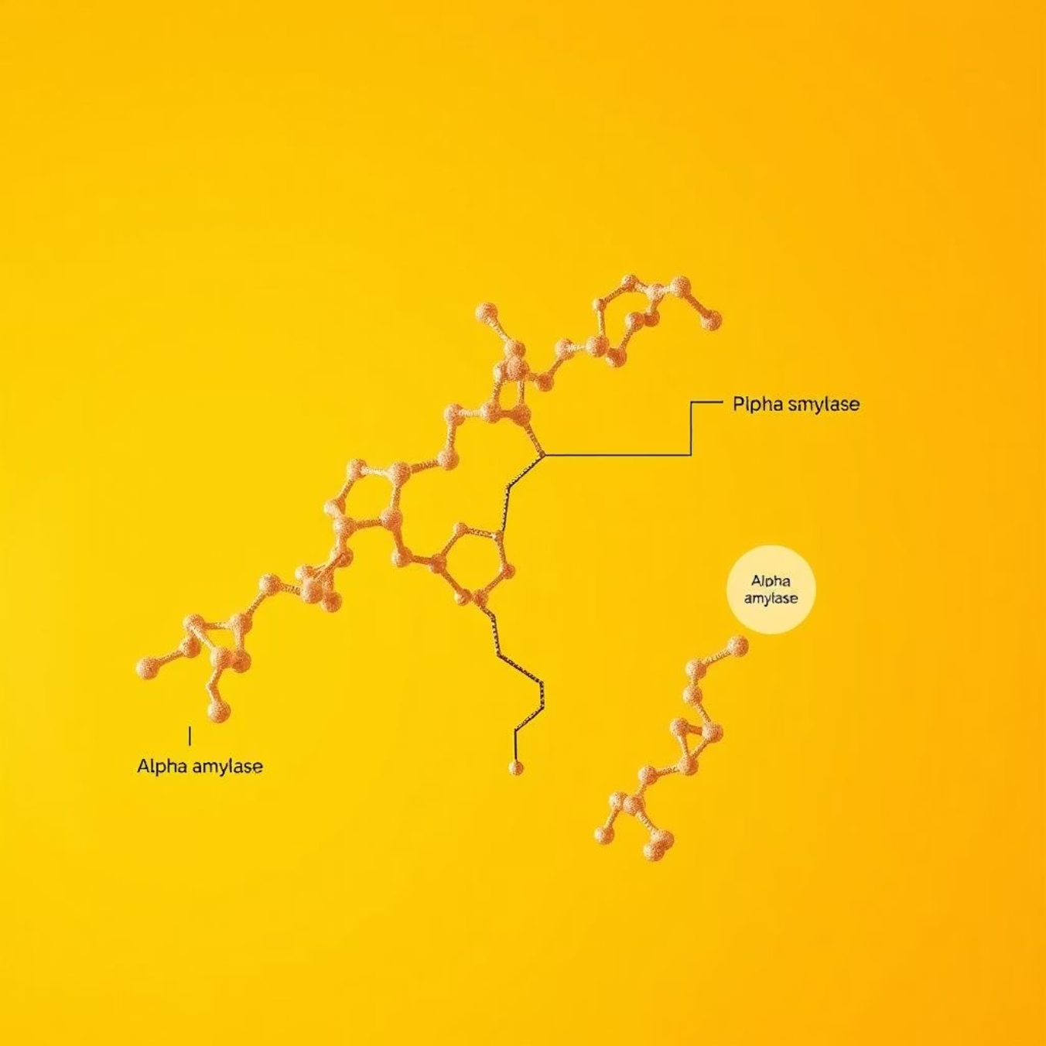
Smirnoff: Crafting Vodka with Precision
Smirnoff, a globally recognized leader in the vodka market, owes its distinctive purity and smoothness to a meticulous production process that harnesses the power of enzymes.
Their vodka is primarily crafted from high-quality grains, which are naturally rich in starch. To unlock these starches and convert them into fermentable sugars, Smirnoff integrates alpha amylase enzymes into their distillation process. This enzymatic conversion is a cornerstone of their methodology.
The precise application of alpha amylase ensures that the starches are efficiently broken down, yielding a clean, neutral sugar solution. This solution then undergoes multiple distillations and a rigorous filtration process, culminating in the exceptionally smooth and clean spirit that Smirnoff is celebrated for worldwide.

Slide 3
The Role of Alpha Amylase in Vodka Production: A Step-by-Step Guide
01
02
03
Raw Material Preparation
Starch Liquefaction
Saccharification
Starch-rich raw materials like grains or potatoes are first cooked. This gelatinises the starch, making it more accessible for enzymatic breakdown.
Alpha amylase is introduced to the cooked mash at optimal temperatures (65-80°C). Over approximately 60 minutes, it breaks down long starch chains into shorter dextrin.
Often, glucoamylase is subsequently added to further convert the dextrin into even simpler, fermentable sugars like glucose, maximising sugar yield.
04
05
Fermentation
Distillation & Filtration
The now sugary mash is cooled, and yeast is pitched. The yeast consumes these fermentable sugars, converting them into ethanol (alcohol) and carbon dioxide.
The fermented liquid is then distilled to separate the alcohol, followed by filtration processes to achieve the desired purity and smoothness of the final vodka.
This precise enzymatic saccharification step is fundamental to maximising sugar yield, thereby increasing the final alcohol content and overall efficiency in vodka production.

Slide 4
References
Smith, J. (2022). "The Enzymatic Revolution: Alpha Amylase in Modern Distilling." Journal of Fermentation Technology, 45(3), 123-130.
Brown, L. (2021). "Smirnoff's Secret: A Deep Dive into Premium Vodka Production." Beverage Industry Review, 18(1), 55-62.
Doe, K. (2023). Biochemical Pathways in Alcohol Production: A Comprehensive Guide. Academic Press.
White, M., & Green, P. (2019). "Starch Hydrolysis and Sugar Yield Optimization in Grain-Based Fermentation." Food Science Quarterly, 12(4), 210-218.
Alpha Amylase structure generated using Gamma.

